Slide 1
Software Testing Course’s Code: CSE 453 Automated Tool support for Testing [Chapter 5]

Slide 2
Chapter 5
Chapter 5. Automated Tool support for Testing
5.1 Automated Mock Framework
5.2 API Testing
5.3 Web Testing
5.4 Behaviour Driven Development (BDD)

Slide 3
What is a test tool
A test tool is a software product that supports one or more test activities, such as planning and control, specification, building initial files and data, test execution and test analysis.
Types of Test Tool
Test Management Tools
Requirements Management Tool
Configuration Management Tool
Test Execution Tool -> Testing with code [In this course]
Test Design Tool
Record (or capture playback) tools -> Codeless Testing

Slide 4
Consideration during Automated Testing
Developing software to test the software is called test automation/automated testing
Clear and reasonable expectation should be established in order to know what can and what can not be accomplished with automated testing
There should be a clear understanding of the requirements that should be met in order to achieve successful automated testing
Select a tool that allows the implementation of automated testing in a way that conforms to the specified long-term testing strategy

Slide 5
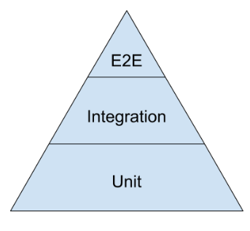
Automated Tool Support towards Different levels of testing pyramid
Selenium, Cypress, Playwright, Appium
Postman for API testing tool manually,
Rest Assured for automated API testing tool, [This also follow BDD]
Pact for Consumer Driven Contract testing tool,
Cucumber follows BDD [Behavior Driven Development]
Mockito to test interfaces between different components of a software
WireMocks for API testing
Junit, TestNG, Mockito for Java language
Jest for java script
Nunit for .net languages
pytest for python
This is not the Complete List
More tools exist
Go for a search

Slide 6
End to End Test using Selenium (Web Testing)
Selenium,
Cypress,
Playwright,
Appium

Slide 7
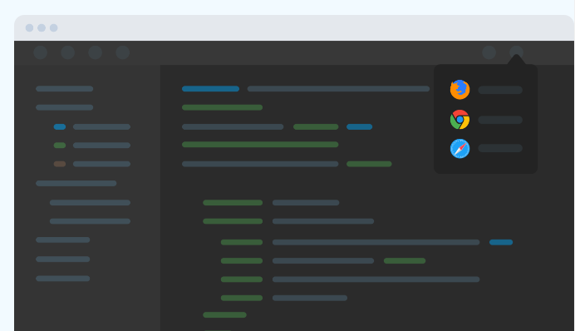
What is web application testing?
When a website is deployed, anything can happen: broken links, difficult navigation, web security, and many other potential risks. A careful testing process is key to reducing these risks and maintaining web quality.
Web app testing, or web testing, is a software testing practice that helps ensure the quality and functionalities of the app according to the requirements.
Web testing must detect all underlying issues, such as functional discrepancies, security breaches, integration problems, environmental issues, or traffic stress before it is delivered.

Slide 8
Web Application Testing Techniques
Web App Functionality Testing
One of the most common tests for web apps. Functionality testing checks if the initial build works as per its design. It often covers link testing, form validation, cookie testing, HTML and CSS validation, and database connection checkup.
Web App Interface Testing
Interface testing examines how the web interface responds to emulated interruptions, as well as its compatibility and interaction between different servers. Three key areas to focus on are the application server, web server, and database server.

Slide 9
Web Application Testing Techniques
Web App Compatibility Testing
Compatibility testing checks whether or not the web design is compatible with a variety of browsers and devices. This includes browser and OS compatibility testing, along with mobile browsing and printing options testing..
Web App Performance Testing
Performance testing is load testing for web apps. Besides the tests on traffic load, stress tests and scalability tests are also crucial to the web performance, especially when it is potentially released to a large audience.

Slide 10
How to Effectively Test a Website Application?
Rigorously carry out cross-browser compatibility testing
Define and select key parameters for usability tests
Execute performance tests under various conditions
Apply tests to all elements, third-party, and extensions of the web app
Ensure load tests are incrementally performed
Incorporate exploratory testing into the software development lifecycle
Involve the development team throughout the testing process

Slide 11
Introduction to Selenium
Primarily Selenium is for automating web applications for testing purposes. The principle use is front-end(UI) testing of websites.
Boring web-based administration tasks can (and should) also be automated as well.
This is one kind of end-to-end testing tool
Selenium automates web browsers. It is most famous for enabling rapid, repeatable web-app testing, which allows developers to ship new releases faster and with confidence.
Selenium is an umbrella project for a range of tools and libraries that enable and support the automation of web browsers
This is the official website of Selenium : https://www.selenium.dev/
Selenium is an Open Source project

Slide 12
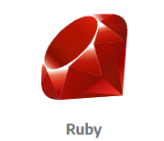
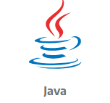
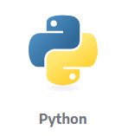
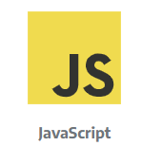
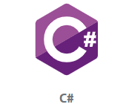









Introduction to Selenium
Selenium supports several programming languages:
Supports different OS: Windows, Mac, Linux
Supports different browsers: Edge, Chrome, Opera, Firefox, Safari, Internet Explorer

Slide 13
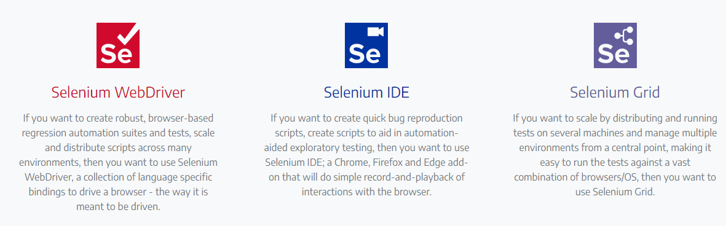
Introduction to Selenium
Three kinds of products are come under Selenium project

Slide 14
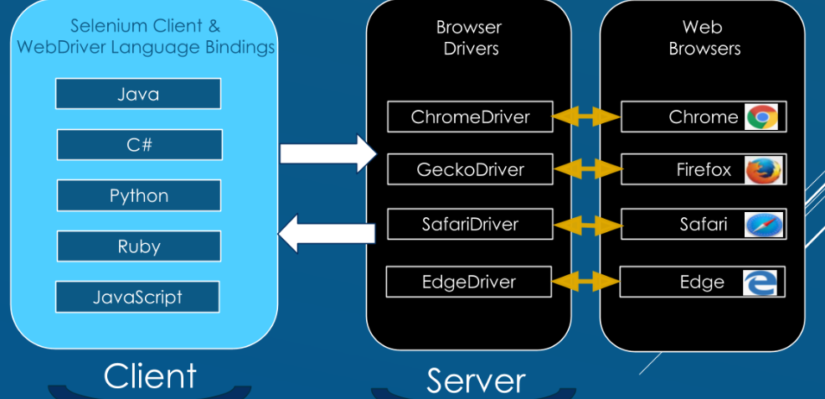
Architecture of Selenium 4

Slide 15
Architecture of Selenium 4
The first component has 2 parts combined into one — Selenium Client is a separate part and WebDriver Language Bindings is a different part.
Selenium is an API that has commands for automating our browser.
WebDriver talks to the web browser through a browser driver. All the languages have their own bindings. Bindings mean the same commands written for Java is also written for C#, Python, Ruby, and JavaScript.
The second component is Browser Drivers, and we see it has 2 functions.
The first function receives a request from Selenium Client and WebDriver Language Bindings, then passes that request to the browser. A driver is also known as a proxy, which has the responsibility for controlling the browser.
The second function is to return a response from the browser back to the Selenium Client and WebDriver Language Bindings. All the drivers use a W3C WebDriver Protocol, and most of them are created by the browser vendors.
The third component is Web Browsers.
This is where all of the Selenium commands are performed.
Here's the process. The browser receives a performance request and sends back a response to the driver.

Slide 16





How to Set Up Selenium 4
We need to create a maven project. In this course, We will use
Selenium-java : Programming Language to write test scripts
Eclipse: IDE to compile and run scripts
WebDriverManager: Automated driver management and other helper features for Selenium WebDriver in Java
Junit5: Execution of codes in Test Cases

Slide 17
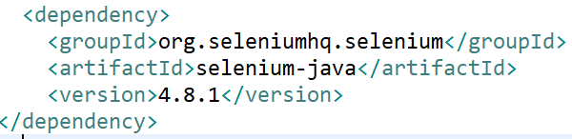
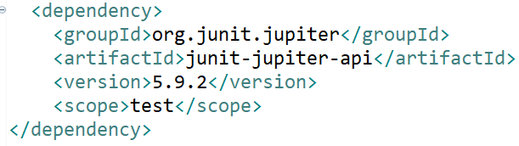
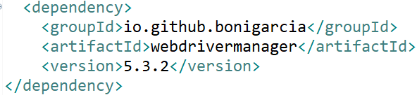
Maven Dependency for Selenium 4 webdriver
We will add the Maven Dependencies for Selenium-Java, Web Driver Manager and Junit5

Slide 18
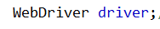
1st Test using Selenium
Create a JUNIT class under the package of src/test/java folder
This time check BeforeAll, Before Each, AfterEach method
Step 1: Create an object of WebDriver class
Step 2: Under @BeforeAll, setup the web driver manager. Let’s assume, we want to automate Chrome Browser.
Step 3: The session will be started. This step will be implemented under @BeforeEach
driver=new ChromeDriver();

Slide 19
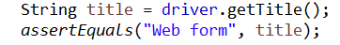
1st Test using Selenium
Step 4: Take actions on Browser. In this example, we are navigating to a web page. This step also can be implemented under @BeforeEach
Step 4: In this step, we will also do one more task that is to maximize the window.
We can also automate full screen and custom size window of the page
Step 5: Request browser information. There are a bunch of types of information about the browser you can request, including window handles, browser size / position, cookies, alerts, etc. This step will be implemented under @Test.
In this example, we will test the title of the web page

Slide 20
1st Test using Selenium
Step 6: Establish Waiting Strategy. Read more about Waiting strategies. This step can also be implemented under @Test.
The Implicit Wait in Selenium is used to tell the web driver to wait for a certain amount of time before it throws a “No Such Element Exception”. The default setting is 0. Once we set the time, the web driver will wait for the element for that time before throwing an exception.
Step 7: Find an Element. The majority of commands in most Selenium sessions are element related, and you can’t interact with one without first finding an element. This step can also be implemented under @Test.
In this example, we will find one textbox named as my-text and submit buttion.

Slide 21
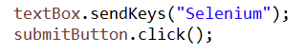
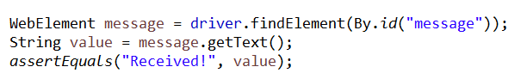
1st Test using Selenium
Step 8: Take action on element. There are only a handful of actions to take on an element, but you will use them frequently. This step can also be implemented under @Test.
In this example, “Selenium” is written inside the text box and submit button will be clicked.
Step 9: Request element information. Elements store a lot of information that can be requested.
In this example, a web element is found out by id(“message”), then information of that element is requested using getText(). Next the value of the text is tested.
Step 10: End the session. This ends the driver process, which by default closes the browser as well. No more commands can be sent to this driver instance.

Slide 22
1st Test using Selenium
Step 10: End the session. This ends the driver process, which by default closes the browser as well. No more commands can be sent to this driver instance. This step can be implemented under @AfterEach.
Step 11: Run the class as a junit. You can see chrome browser will be started automatically and do all the tasks that you have specified in the program

Slide 23
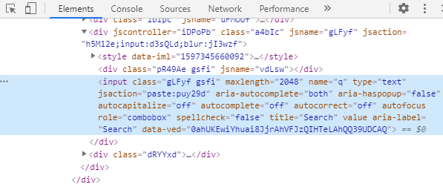
Locators in Selenium
Locators can be termed as an address that identifies an web element uniquely on a web page
These are the HTML properties of a web element

Slide 24
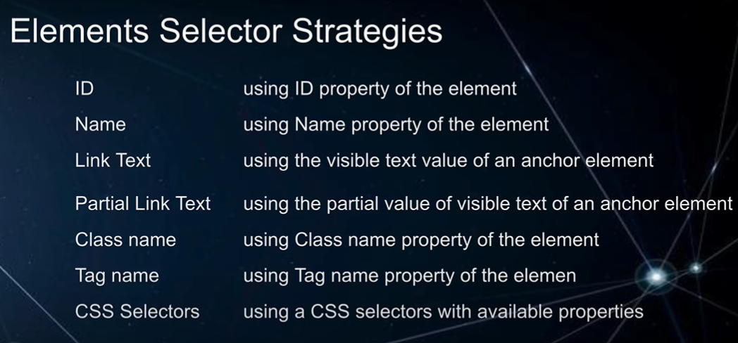
Locators in Selenium
There are different ranges of web elements like radio button, text box, id etc.
Identifying these element is a tricky approach
Selenium uses locators to interact with the web elements on a web page
The locator is a "property-value" pair – For example "id" is the property and "email" is the value

Slide 25
ID Locator in Selenium
Ids’ are the most preferred way to locate elements on a web page, as each id is supposed to be unique which makes ids faster and more reliable way to locate elements on a page.
With ID Locator strategy, the first element with the id attribute value matching the location will be returned.
A NoSuchElementException will be raised, if no element has a matching id attribute.
Example: Now, let’s understand the working of ID locator with an example. Here we will launch Google Chrome and navigate to yahoo.com. Here, We will try to locate the email text box using ID Locator.

Slide 26
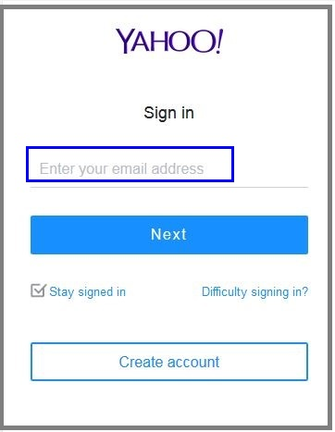
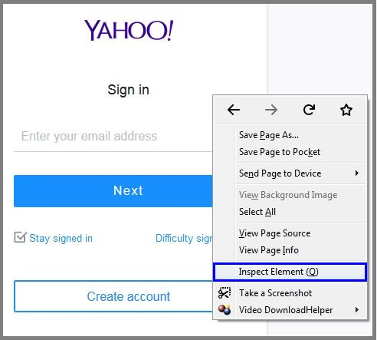
ID Locator in Selenium
Use the same in your Selenium test script as well:
driver.findElement(By.id("login-username")).sendKeys("seleniumtesting@yahoo.com"); //id locator for text box
Right-click on the above web element to inspect the element.

Slide 27
Name Locator in Selenium
This is also the most efficient way to locate an element with a name attribute. With this strategy, the first element with the value name attribute will be returned.
A NoSuchElementException will be raised, if no element has a matching name attribute.
Example: Now, let’s understand the working of the name locator with an example. In the below image you can see, the name locator with a value called username. The difference is that you should use a name instead of id.

Slide 28
Name Locator in Selenium
Use the same in your Selenium test script as well:
driver.findElement(By.name("username")).sendKeys("seleniumtesting@yahoo.com"); //name locator for text box
The tagName and className locators are similar to ID and name locators. They are used to select the elements having the html tag or css class.

Slide 29
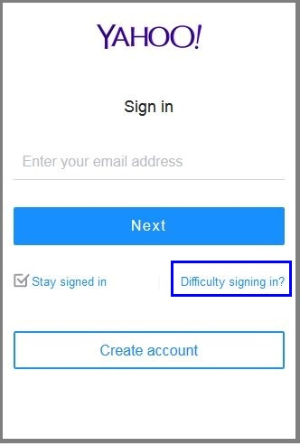
linkText Locator in Selenium
Selenium linkText locator is used for identifying the hyperlinks on a web page. It can be identified with the help of an anchor tag “a”. In order to create the hyperlinks on a web page, you can use anchor tags.
Example: Now, let’s understand the working of the linkText locator with an example. Suppose you want to locate ‘Difficulty signing in?’ link as shown below.

Slide 30
linkText Locator in Selenium
Right-click on “Difficulty signing in?” link for inspecting-you can notice that it starts with an anchor tag, which doesn’t have any id and name attributes. In those cases, you can use linkText locator.
driver.findElement(By.linkText("Difficulty signing in?")).click(); //linkText locator for links

Slide 31
partialLinkText Locator in Selenium
In some situations, we may need to find links by a portion of the text in a linkText element. In those situations, we use Partial Link Text to locate elements.
Example: Now, let’s understand the working of PartiallinkText locator with an example. Suppose you want to locate ‘Difficulty signing in?’ link as shown below.
Right click on “Difficulty signing in?” link for inspecting. Now, instead of pasting full text we will give just Difficulty.
driver.findElement(By.partiallinkText("Difficulty")).click(); //partiallinkText locator for links

Slide 32
XPath Locator in Selenium
XPath also called as XML Path is a language to query XML documents. XPath is an important strategy to locate elements in selenium.
Example: Now, let’s understand the working of XPath locator with an example. Suppose you want to locate the search box using XPath of google.com. On inspecting the web element you can see an input tag and attributes like class and name. To construct XPath we make use of tag names and attributes to locate the search bar.

Slide 33
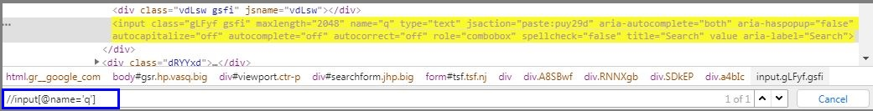
XPath Locator in Selenium
Click the Elements tab and press Ctrl + F to open a search box in Chrome’s developer’s tool. In the above image, you can see an input tag.
Now, I will start with //input, where //input implies a tag name. Here we make use of name attribute and pass ‘q’ in single quotes as its value.
This will give the below XPath expression:
//input[@name=’q’]
driver.findElement(By.xpath("//input[@name='q']")).sendKeys("Selenium Webdriver"); //xpath for search box

Slide 34
CSS Selectors in Selenium
CSS Selector is the combination of an element selector and a selector value which identifies web element within a web page. Like Xpath, CSS Selector is also used to locate web elements having no ID, class or Name.
Example: Now, let’s understand the working of CSS Selector with an example. Here we will launch Google Chrome and navigate to yahoo.com. Here, I will try to inspect the email text box using CSS Selector.

Slide 35
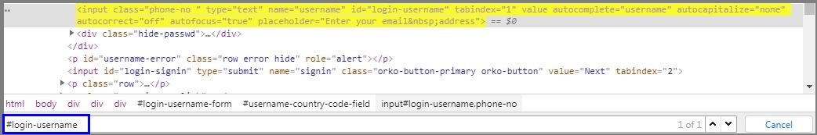
CSS Selectors in Selenium
Once inspecting the element, we can see the image as below
Click Elements tab and press Ctrl + F to open a search box in Chrome’s developer’s tool. In this case, CSS Selector will start with # and on giving the value of id attribute as login-username, the element gets highlighted.
driver.findElement(By.cssSelector("#login-username")).sendKeys("seleniumtesting@yahoo.com");

Slide 36
CSS Selectors in Selenium
Other Selectors => By.cssSelector
----------------------------- => --------------
By.className("register") => ".register"
By.tagName("table") => "table"
By.id("unique_id") => "#unique_id"
By.name("login") => "[name=login]"
By.xpath("//body/nav") => "body > nav"
By.xpath("//body//nav") => "body nav"

Slide 37
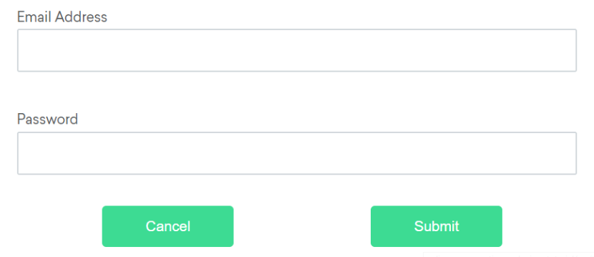
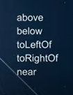
Selenium 4: Relative Locators
https://www.selenium.dev/documentation/webdriver/elements/locators/
These locators are helpful when it is not easy to construct a locator for the desired element, but easy to describe spatially where the element is in relation to an element that does have an easily constructed locator.

Slide 38
Selenium 4: Relative Locators
Above
If the email text field element is not easily identifiable for some reason, but the password text field element is, we can locate the text field element using the fact that it is an “input” element “above” the password element.

Slide 39
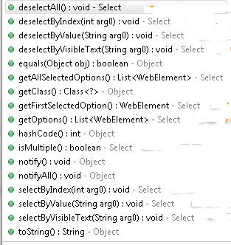
Select Class in Selenium – How to handle Dropdown
Select class is a WebDriver class provides the implementation of the HTML Select tag
Syntax: Select oselect=new Select(findElementBy.id(“id”));
oselect.
https://www.selenium.dev/documentation/webdriver/elements/select_lists/

Slide 40
Select Class in Selenium – How to handle Dropdown
The select class has several methods to select or de-select dropdown's values -
selectByVisibleText("parameter")
deselectByVisibleText("parameter")
selectByIndex(index)
deselectByIndex(index)
selectByValue("value")
delectByValue("value")
The select class provides one method to check whether drop-down allows a user to select multiple values -
isMultiple() - returns true if dropdown allows multiple selection, otherwise false.
To deselect multiple selected values - deselectAll()

Slide 41
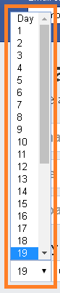
Select Class in Selenium – How to handle Dropdown
parameter - represents the value of dropdown.
index - represents the index of the dropdown's value. It starts with 0, i.e., the index of the first value of dropdown is zero.
value - represents the value of "value" property.
How to access?
First, identify the dropdown field on the webpage.
Then we can select or unselect values from it.

Slide 42
Select Class in Selenium – How to handle Dropdown
Code - selectByVisibleText() -
WebElement daytext = driver.findElement(By.id("day"));//identifing the 'day' dropdown available on facebook login page.
Select select = new Select(daytext);//instantiating the dropdown elements as Select class object.
select.selectByVisibleText("10");//selecting value from dropdown.
Explanation - "day" is the drop-down element having day values from (1-30/31).
"select" is the object of the Select class that refers to "day" dropdown's values.
We are selecting "10" as the text parameter.

Slide 43
Select Class in Selenium – How to handle Dropdown
selectByIndex() -
WebElement dayIndex = driver.findElement(By.id("day"));//identifing the 'day' dropdown available on facebook login page.
Select select = new Select(dayIndex);//instantiating the dropdown elements as Select class object. select.selectByIndex(11);//selecting value from dropdown.
Explanation - "day" is the drop-down element having day values from (1-30/31).
"select" is the object of the Select class that refers to "day" dropdown's values.
We are selecting "11" as the index value. It will select "11" as the date in the drop-down.

Slide 44
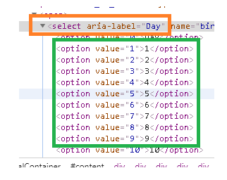
Select Class in Selenium – How to handle Dropdown
selectByValue() -
Here, I inspected "day" drop-down using developer tool. In the image you can see options available for the dropdown. You can see "value" property and its value beside <option> tag. In the below code, we will use this value.
WebElement dayValue = driver.findElement(By.id("day")); //identifing the 'day' dropdown available on facebook login page.
Select select = new Select(dayValue); //instantiating the dropdown elements as Select class object. select.selectByValue("11"); //selecting value from dropdown
Explanation - "day" is the drop-down element having day values from (1-30/31).
"select" is the object of the Select class that refers to "day" dropdown's values.
We are selecting "11" as the value. It will select "11" as the date in the drop-down..

Slide 45
Select Class in Selenium – How to handle Dropdown
getOptions() -
This method helps to get all the options belonging to a select tag. It takes no parameters and returns a list of web elements
Select oselect= driver.findElement(By.id("day")); //identifing the 'day' dropdown available on facebook List<WebElement> elementcount= oselect.getOptions();
System.out.println(elementcount.size());

Slide 46
Select Class in Selenium – How to handle Dropdown
Multiple Select attribute is a Boolean expression. When it is present, it specifies that multiple options can be selected at once
isMultiple() -
This method tells whether the select element support multiple select options at the same time or not. It takes no parameters and returns Boolean value
oSelect.isMultiple() -

Slide 47
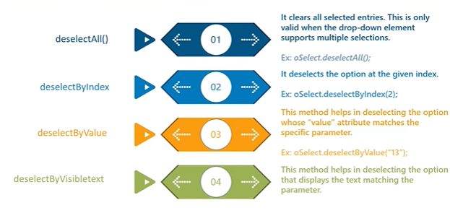
Select Class in Selenium – How to handle Dropdown

Slide 48
Chapter 5
Chapter 5. Automated Tool support for Testing
5.1 Automated Mock Framework
5.2 API Testing
5.3 Web Testing
5.4 Behaviour Driven Development (BDD)

Slide 49
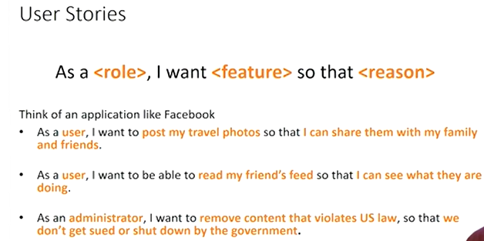
User Stories and Behaviour Driven Development (BDD)
Requirements need to be clear, precise, and unambiguous
To make that we need to develop test cases for each requirement

Slide 50
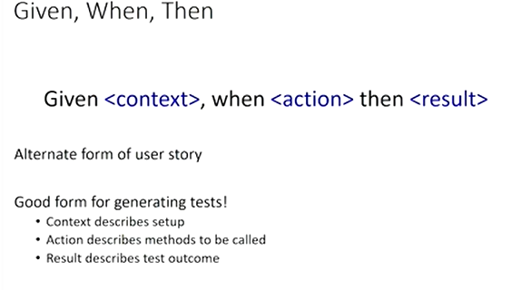
What is Behaviour Driven Development (BDD)?
BDD is defined as a process for software teams to work in a collaborative fashion and to bridge the gap between business and the technical people with respect to requirements, misunderstandings, and assumptions that might impact the delivery piece.

Slide 51
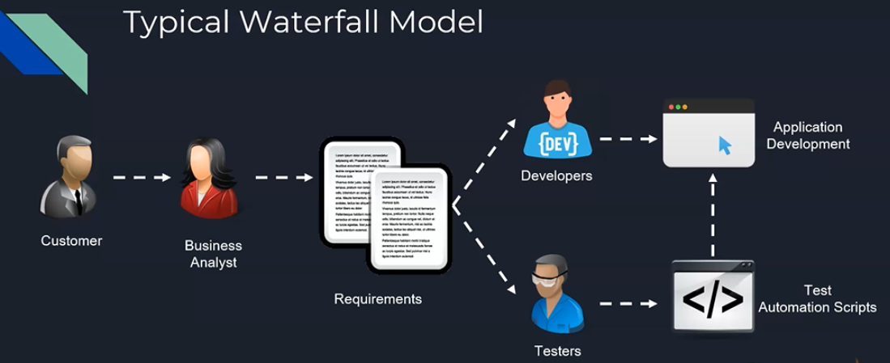
Typical Waterfall Model

Slide 52
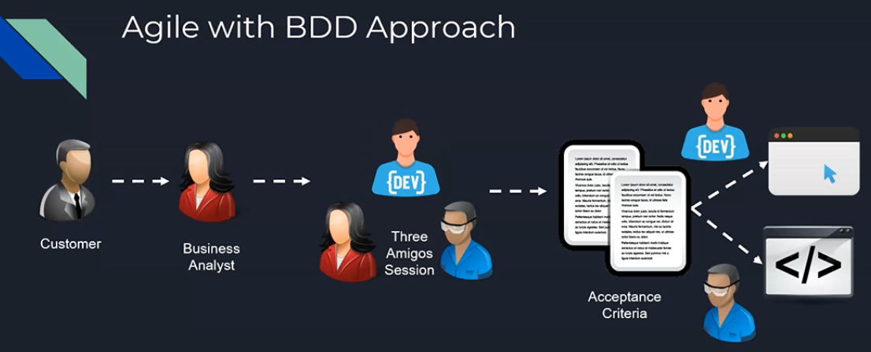
Agile with BDD Approach

Slide 53
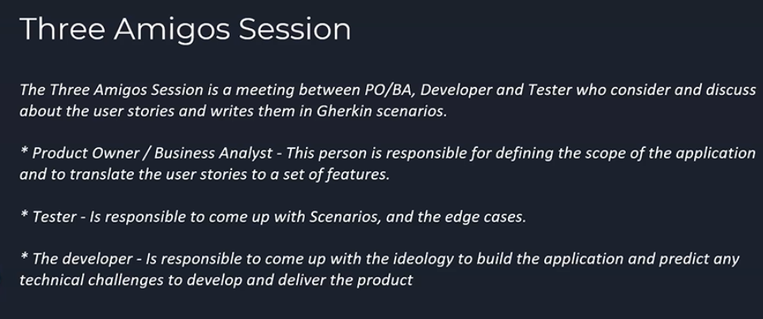
Three Amigoes Session

Slide 54
Introduction to Cucumber
Cucumber is a testing tool for Behavior-Driven Development approach.
It defines application's behavior using simple English and defined by a language called Gherkin.
Gherkin is a special language that is designed for Behavior-Driven Development approach and it is used by many organizations extensively.
It helps to easily read and understand the automated acceptance tests.
Just to recollect, while we were discussing the Three Amigos Session, we learned that the outcome of the session would be the acceptance criteria, isn't it?
These acceptance criteria are nothing but the Scenarios, and it is written in this Gherkin language.

Slide 55
Introduction to Gherkin
Gherkin is a set of grammar rules that makes plain text structured enough for Cucumber to understand.
Moreover, Gherkin is an English text language that helps the Cucumber tool to interpret and execute the automated test scripts, which are nothing but other acceptance tests.
Apart from this, Gherkin serves multiple purposes. These three purposes, which are given here, are the most common ones.
First thing, it addresses the unambiguous executable specifications; and of course, it helps to automate the tests that are related to our application, using Cucumber.
And also, it documents how the system actually behaves as well, using the concepts of living documentation.

Slide 56
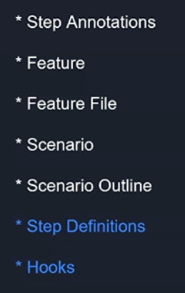
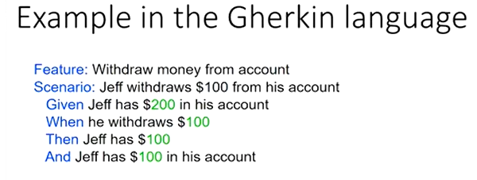
Cucumber and Gherkin
There are totally 7 key concepts that we should understand when it comes to Cucumber and Gherkin.
The first 5 that you're seeing here, the Step Annotations, Feature, Feature File, Scenario and Scenario Outline, are specific to Gherkin.
The Step Definitions and Hooks are something that are related to the test automation framework that we are going to use along with Cucumber.

Slide 57
Installation of Cucumber
Installation:
Creates a maven project in Eclipse.
2. Install cucumber plug-ins in eclipse
3. Add following dependencies in maven project:
Cucumber related files: Cucumber-core, Cucumber Java, junit-jupiter-engine, Cucumber-junit, cucumber-picocontainer, extentreports-cucumber7-adapter,
cucumber-junit-platform-engine
https://cucumber.io/docs/guides/10-minute-tutorial/?lang=java

Slide 58
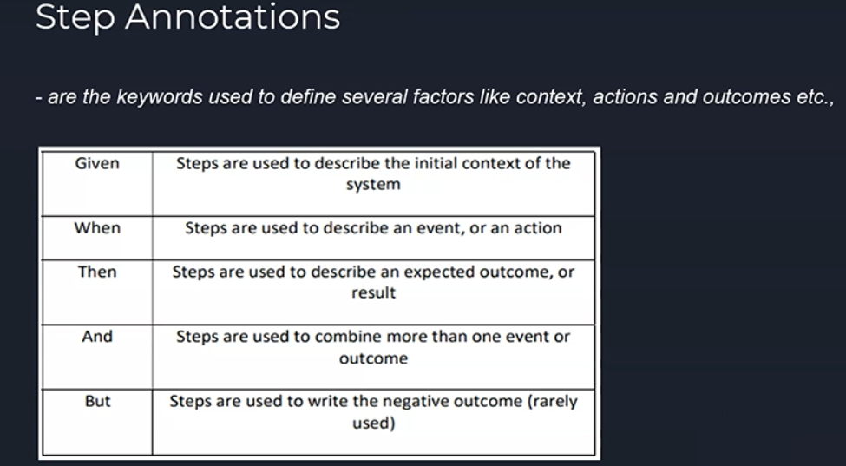
Step Annotations

Slide 59
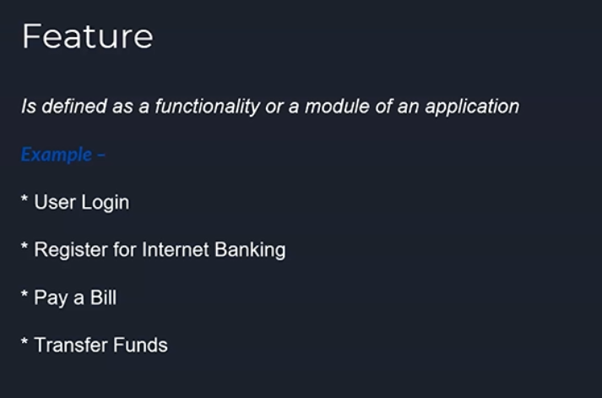
Feature

Slide 60
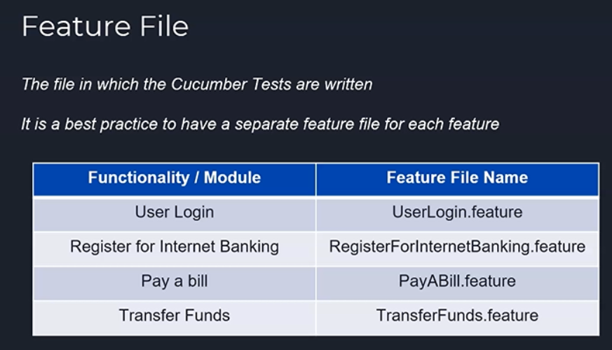
Feature File

Slide 61
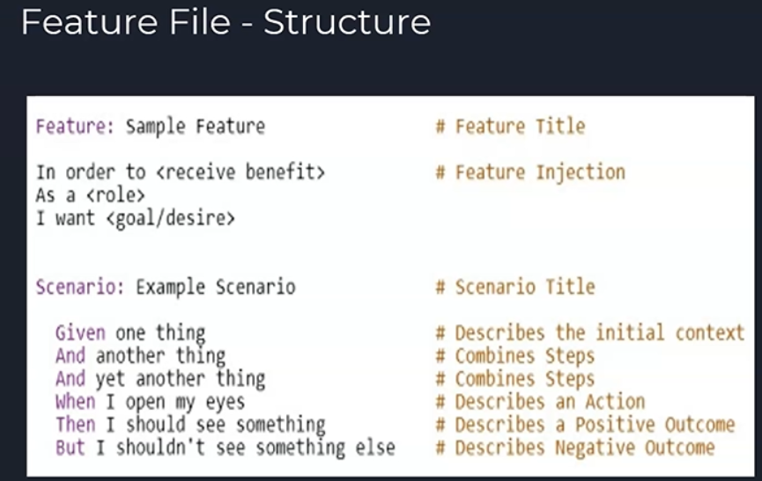
Feature File Structure

Slide 62
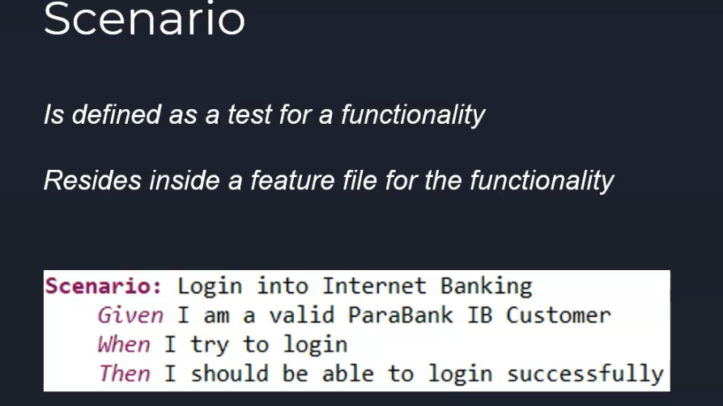
Scenario

Slide 63
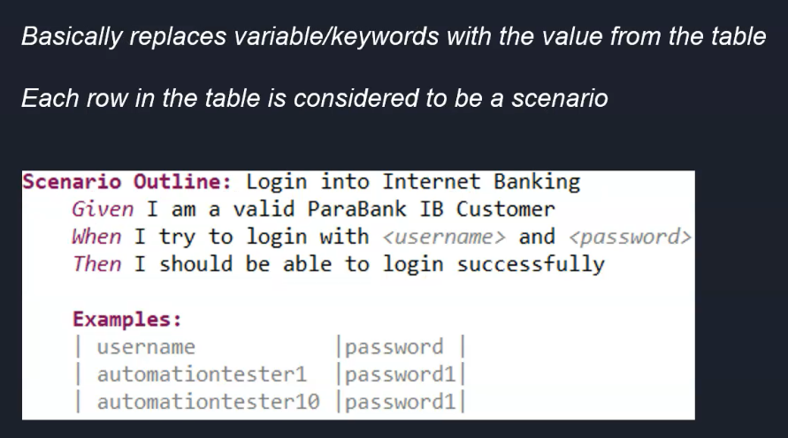
Scenario Outline

Slide 64
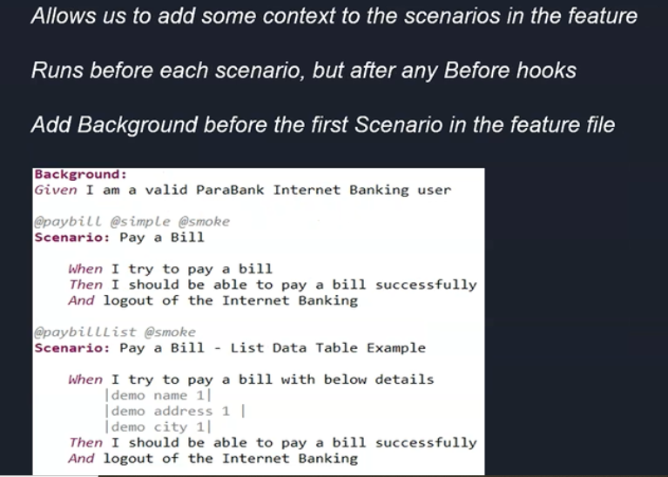
Background

Slide 65
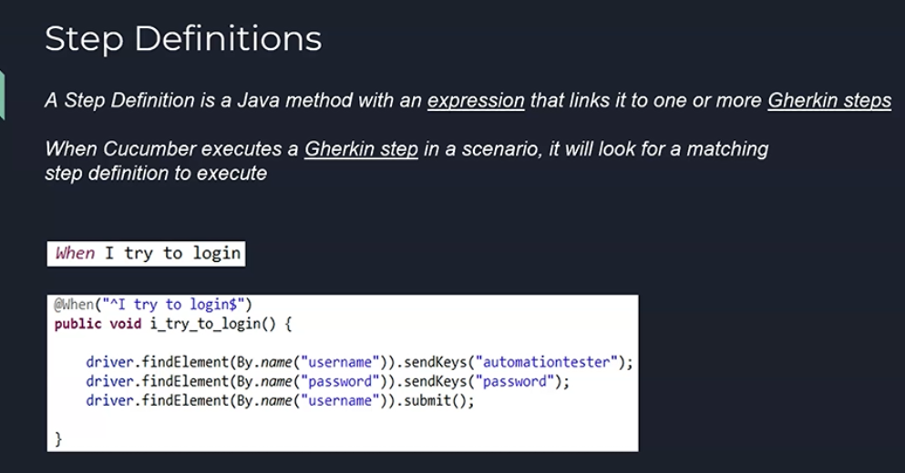
Step Definitions

Slide 66
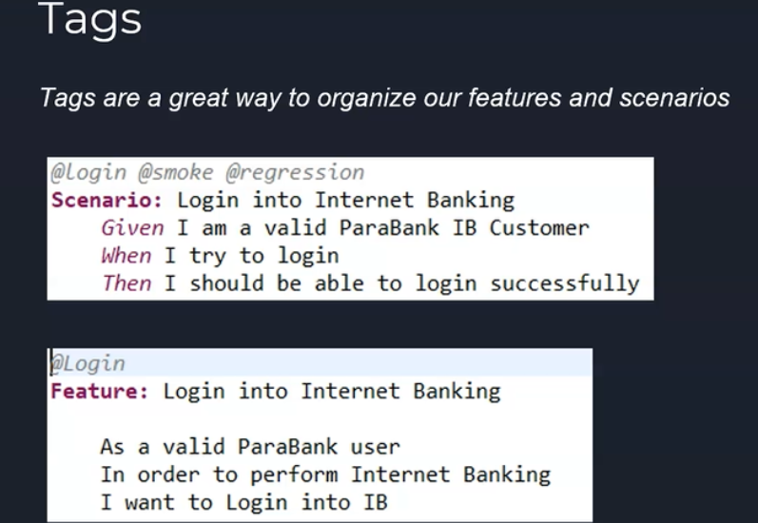
Tags

Slide 67
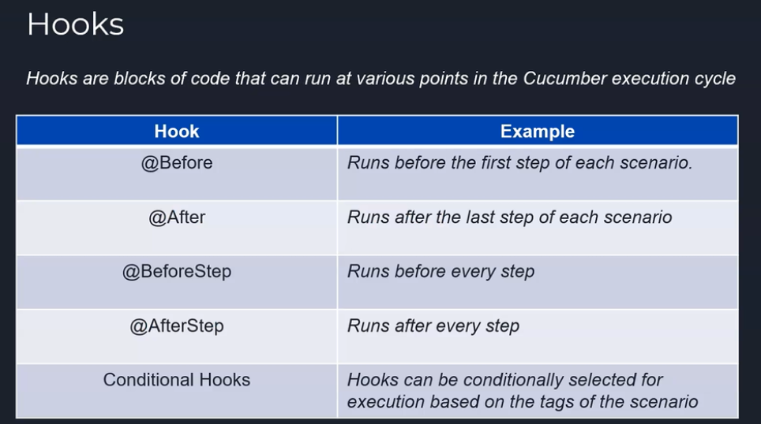
Hooks

Slide 68
3 Golden Rules
3 Golden Rules for Gherkin
We will see about 3 golden rules that we need to follow religiously while writing the Gherkin.
First, in a given Scenario, there should be only one Given, one When and one Then steps — not more than one Given or When or Then should be present as part of the Gherkin file.
The next one is the maximum usage of two And steps are allowed
Make sure your Scenario has maximum of five steps and not more than that.
In case, if it is exceeding, try to split it into two different Scenarios.

Slide 69
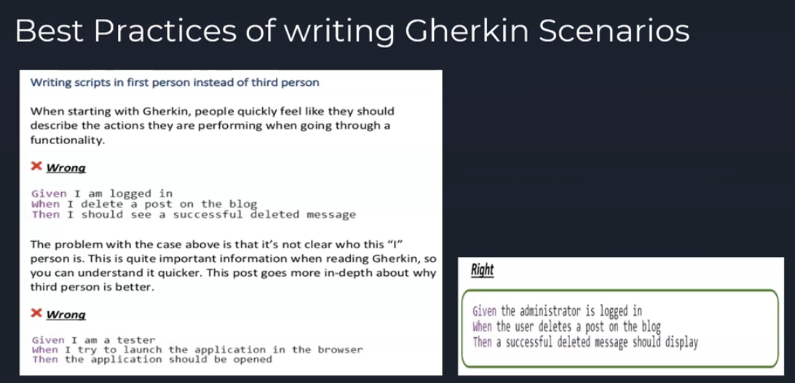
Best Practices of Writing Gherkin Syntaxes

Slide 70
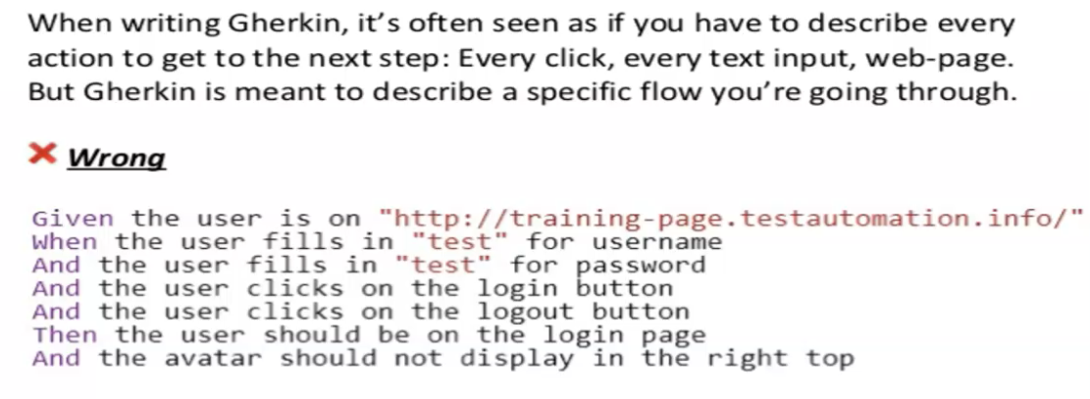
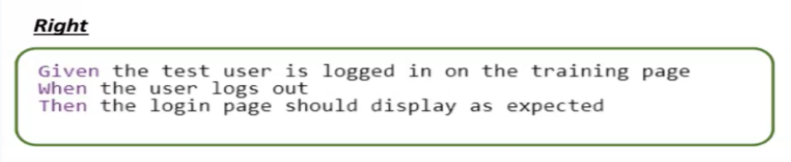
Best Practices of Writing Gherkin Syntaxes

